Slide 1
NEWS WEB
SUBMITTED TO:
Dr. Baljit Kaur
Mr. Vikas Patel
SUBMITTED BY :
Kashish Barthwal,2219990495
Joel Matthew, 2210990465
Jugal, 2210990467
Kanwar, 2210990473

Slide 2
TABLE OF CONTENT:
INTRODUCTION
PROBLEM / TECHNICAL DETAILS
KEY FEATURES
PROJECT HIGHLIGHTS
CONCLUSIONS
REFERENCES

Slide 3
INTRODUCTION:
In today's fast-paced world, access to reliable news is more crucial than ever. Amidst the hustle and bustle of modern society, staying informed about current events not only keeps us connected to the world around us but also provides a sense of stability and understanding in uncertain times.
Welcome to our News Web – your digital portal to the latest happenings, insightful analysis, and thought-provoking stories from around the globe. Designed to be your go-to destination for news consumption, our platform aims to offer a seamless and enriching experience for users seeking to stay informed and engaged.
The purpose of our project is simple yet profound: to develop a news platform that caters to the needs of modern news consumers. With support for mainstream file formats and a user-friendly interface, our News Web ensures that accessing news content is as effortless as pressing play on your favorite music track.

Slide 4
OVERVIEW:
Introducing our News Web, a versatile platform designed to deliver timely, reliable, and engaging news content tailored to meet the diverse needs and preferences of modern news consumers.
Our News Web offers easy access to a wide range of news content, keeping you informed and up-to-date with just a few clicks.
With simple navigation and intuitive design, staying informed has been easier on our News Web platform.
From breaking news to in-depth analysis, our News Web provides a seamless news consumption experience for users of all backgrounds.
Whether you're on the go or relaxing at home, our News Web ensures that accessing the latest news is quick, convenient, and hassle-free.

Slide 5
PROBLEM STATEMENTS:
Accessibility: Providing users with easy access to diverse and credible news sources, ensuring that they can stay informed on a wide range of topics and perspectives.
Personalization: Tailoring news content to individual user preferences and interests, allowing for a more personalized and engaging news consumption experience.
Trustworthiness: Implementing robust fact-checking mechanisms and vetting processes to verify the accuracy and reliability of news articles, thereby combating misinformation and fake news.
User Experience: Designing an intuitive and user-friendly interface with efficient search functionalities, seamless navigation, and visually appealing layouts to enhance the overall user experience.
By addressing these challenges and objectives, our News Web project aims to revolutionize the way users access, consume, and engage with news content online, empowering individuals to make informed decisions and stay connected with the world around them.

Slide 6
TECHNICAL DETAILS:
User Interface:
Our News Web features a user-friendly graphical user interface (GUI) designed to enhance the news consumption experience.
The user interface incorporates intuitive navigation elements such as menus, search bars, and category filters to help users easily find and access news content.
Visual enhancements such as images, enrich the presentation of news content and provide additional context and depth to stories.
API-driven development facilitates seamless integration with third-party services, allowing for the aggregation of news content from multiple sources

Slide 7
KEY FEATURES:
Dynamic Card Templates: Users can browse through news articles presented in visually appealing card templates, making it easy to quickly scan headlines and preview article content.
Responsive Navigation Bar: The navigation bar allows users to effortlessly navigate through different sections of the website, enhancing the user experience and making it simple to find relevant news topics.
Functional Search Bar: The search bar enables users to search for specific news articles or topics of interest, providing a convenient way to access relevant information quickly and efficiently.
Intuitive User Interface: The user interface is designed to be intuitive and user-friendly, ensuring that users can easily interact with the website and find the news content they are looking for without any hassle.

Slide 8
PROJECT HIGHLIGHTS:
HTML CODE:
HTML (Hypertext Markup Language) is a markup language used for creating web pages. It provides the structure and content of a web page, including headings, paragraphs, images, and links.
CSS:
CSS stands for cascading stylesheet. It is used for styling the webpage we have used CSS. It controls the layout, design, and visual appearance of web pages, including elements' colors, fonts, spacing, and positioning.
JAVASCRIPT:
JavaScript is a versatile programming language primarily used for web development. It runs in web browsers, enabling dynamic interaction with web pages. Executed on the client side, it operates within the user's browser, enabling actions such as form validation, animations, and responsive interfaces.

Slide 9
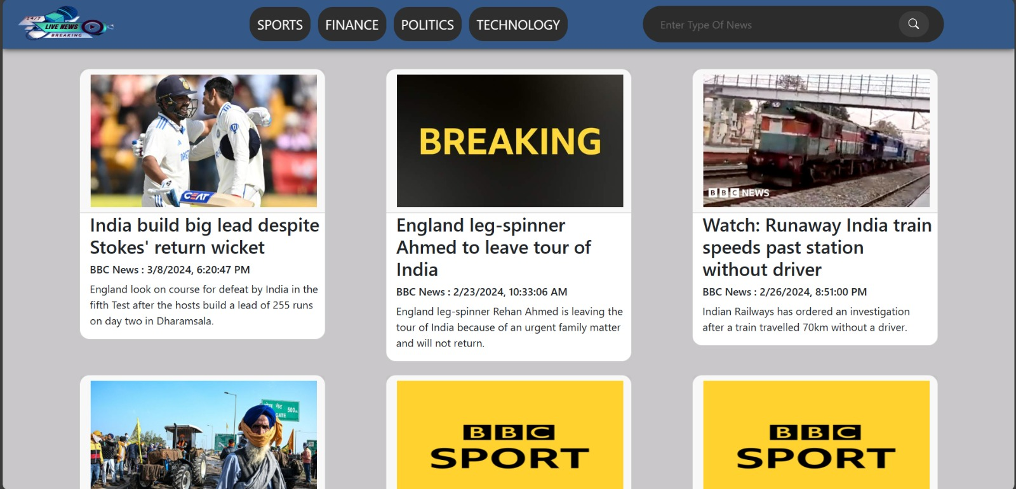
OUTPUT OF OUR CODE:

Slide 10
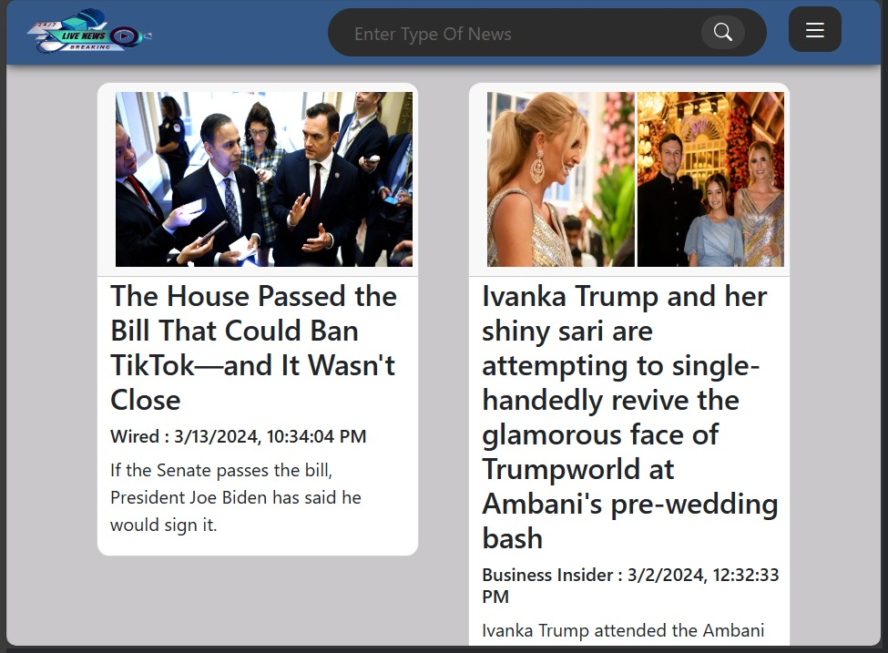

Slide 11
CONCLUSION:
In conclusion, the News Web project aimed to create a user-friendly platform for accessing and consuming news content online. Through the design and development of software components such as card templates, a navigation bar, and a search bar, we have successfully created a seamless and intuitive experience for users to explore and engage with news articles.
A user-friendly interface
Dynamic Card Templates
Interactive Search Bar
Responsive Design

Slide 12
REFERENCES:
References of this project have been taken from the below mentioned sites:
https://www.w3schools.com/
https://www.youtube.com/
https://www.geeksforgeeks.org/
https://www.tutorialspoint.com/
https://en.wikipedia.org/wiki/

Slide 13


